Slide 1


An experimental study on the active noise control using a parametric array loudspeaker
Jiaxin ZHONG, Tong XIAO, Benjamin HALKON, Ray KIRBY, Xiaojun QIU
Centre for Audio, Acoustics and Vibration, Faculty of Engineering and Information Technology, University of Technology Sydney

Slide 2
Outline
Introduction
Experiment Setup
Results and Discussions
Conclusions
Future Work

Slide 3
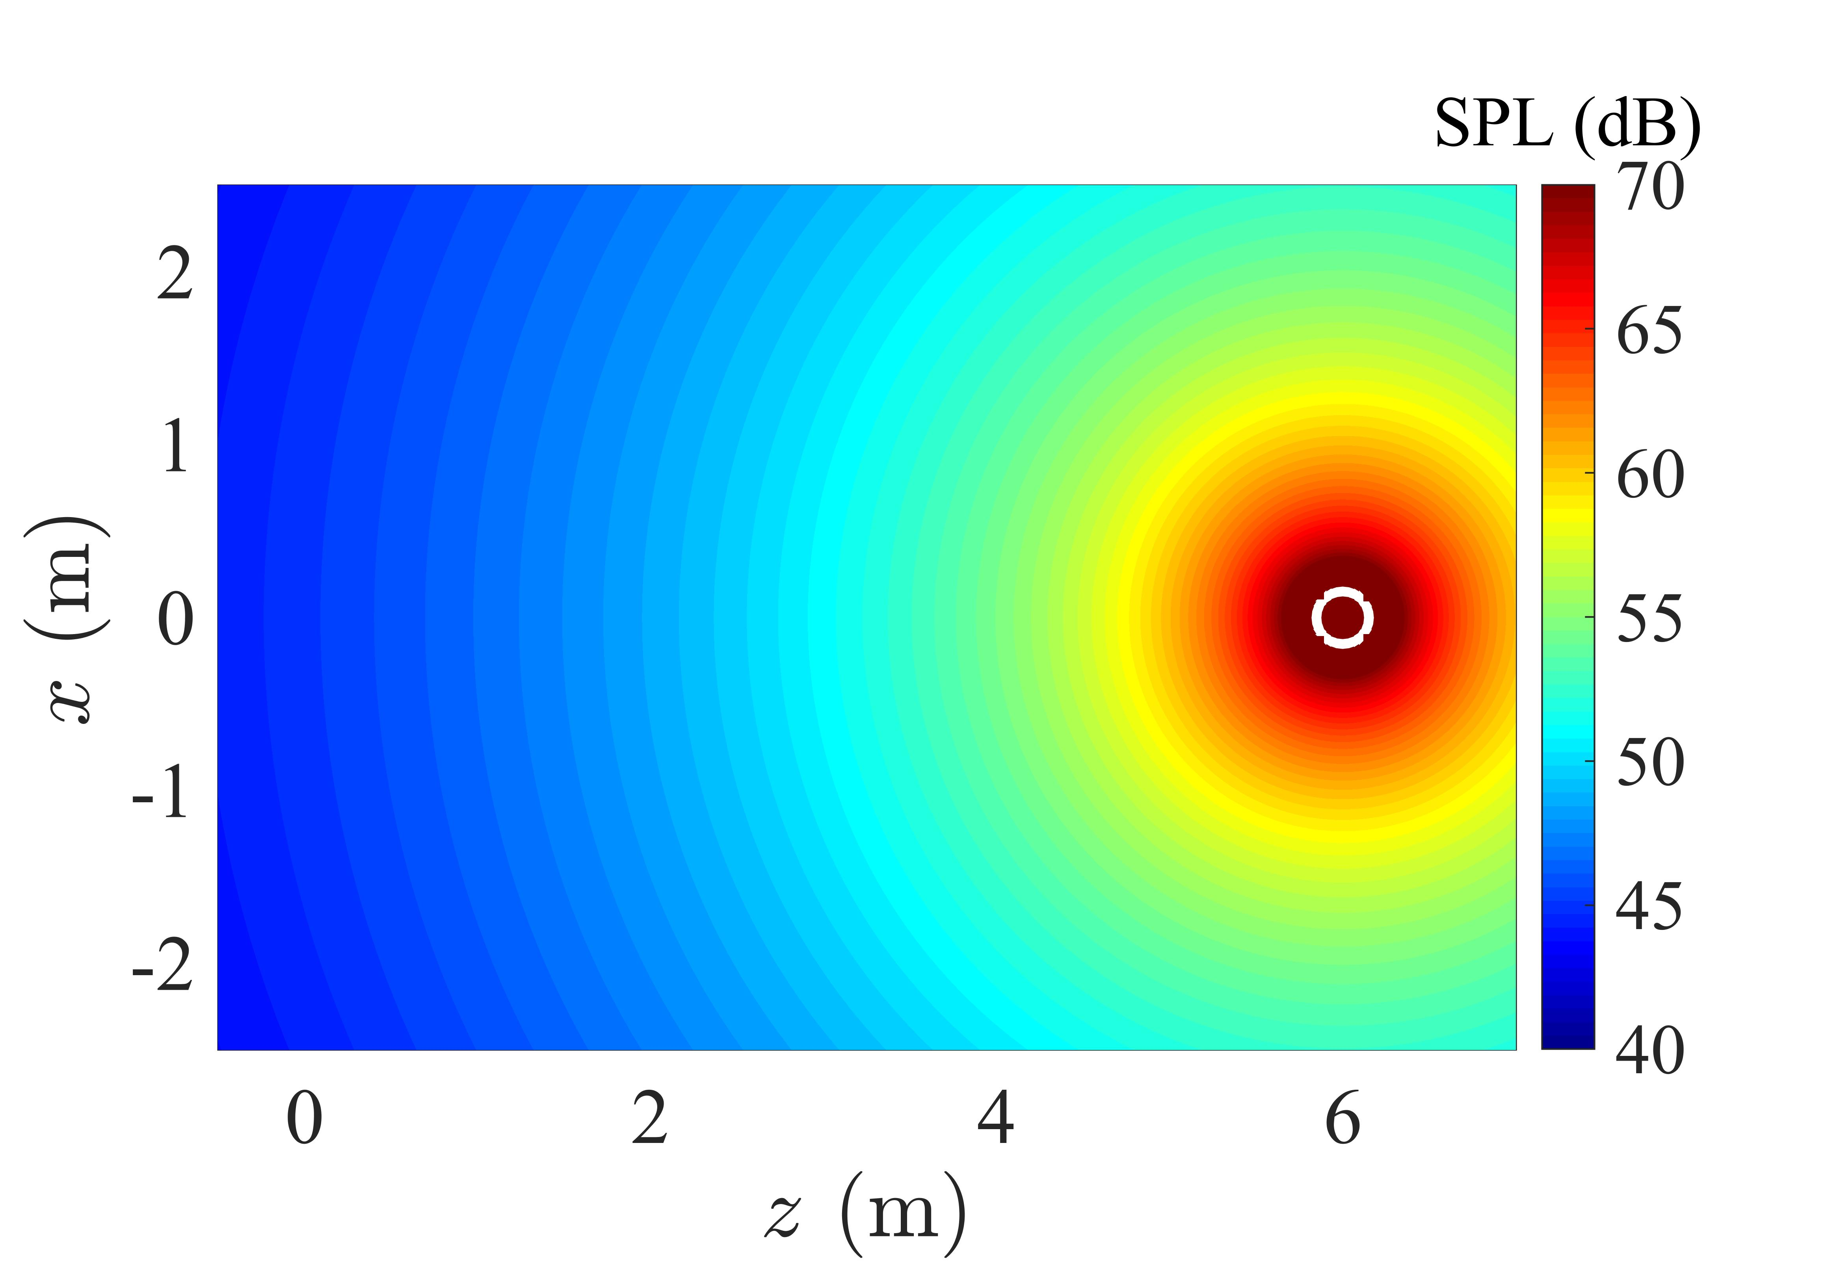
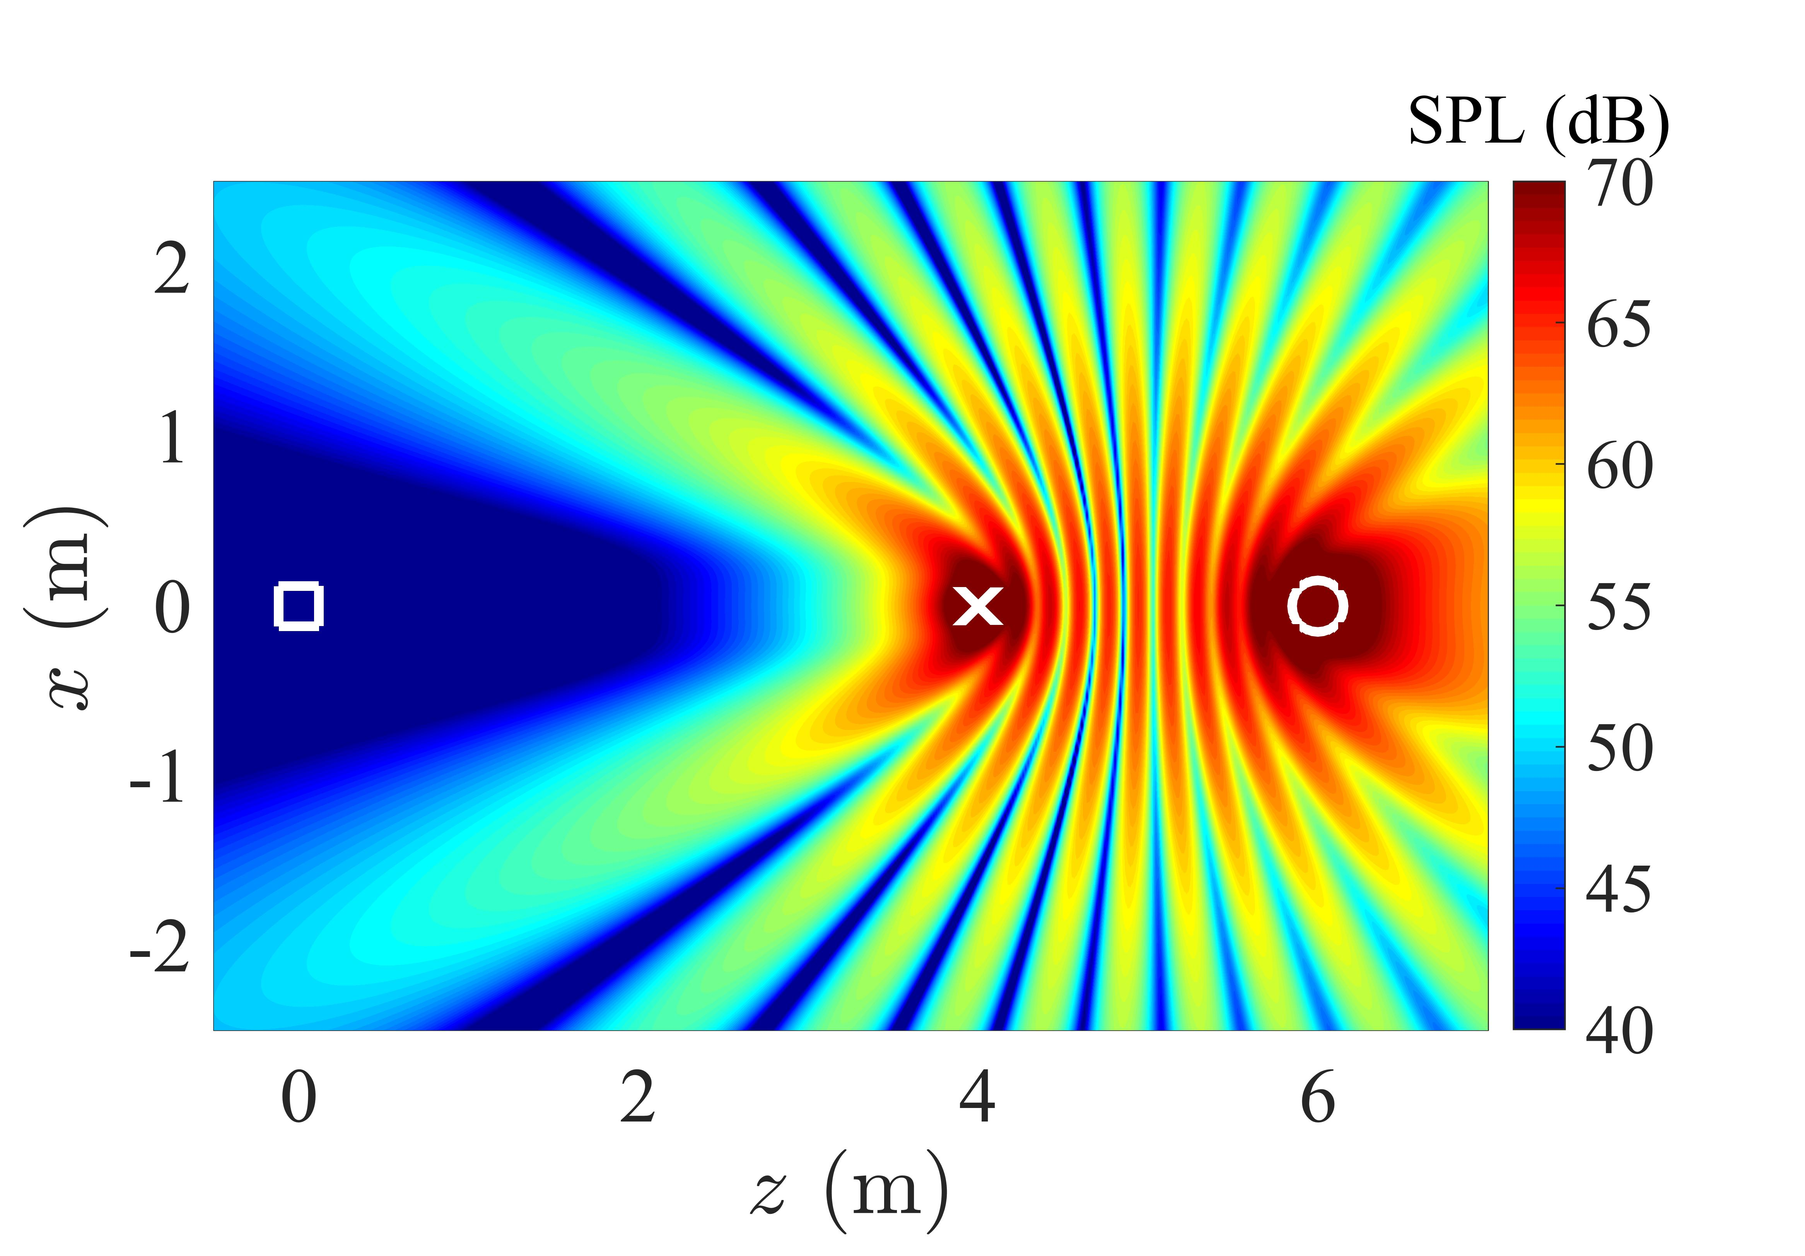
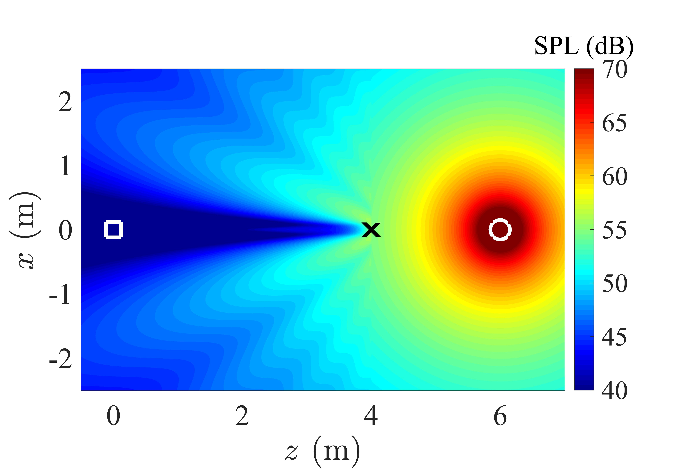

Introduction Active noise control (ANC)
Active noise control (ANC): cancel the noise (primary wave) at target (error) points by introducing secondary loudspeakers (sources)
Problem: the noise at the error point is reduced, but the noise in the other areas is increased
Reason: the omni-directivity of traditional loudspeakers (point source or point monopole)
Solution: using directional loudspeakers
Fig. 1. SPL distribution at 1 kHz: (left) primary field; (center) controlled by an omni-directional source;
(right) controlled by a directional source. O: primary source; ☐: error point; ×: secondary source

Slide 4
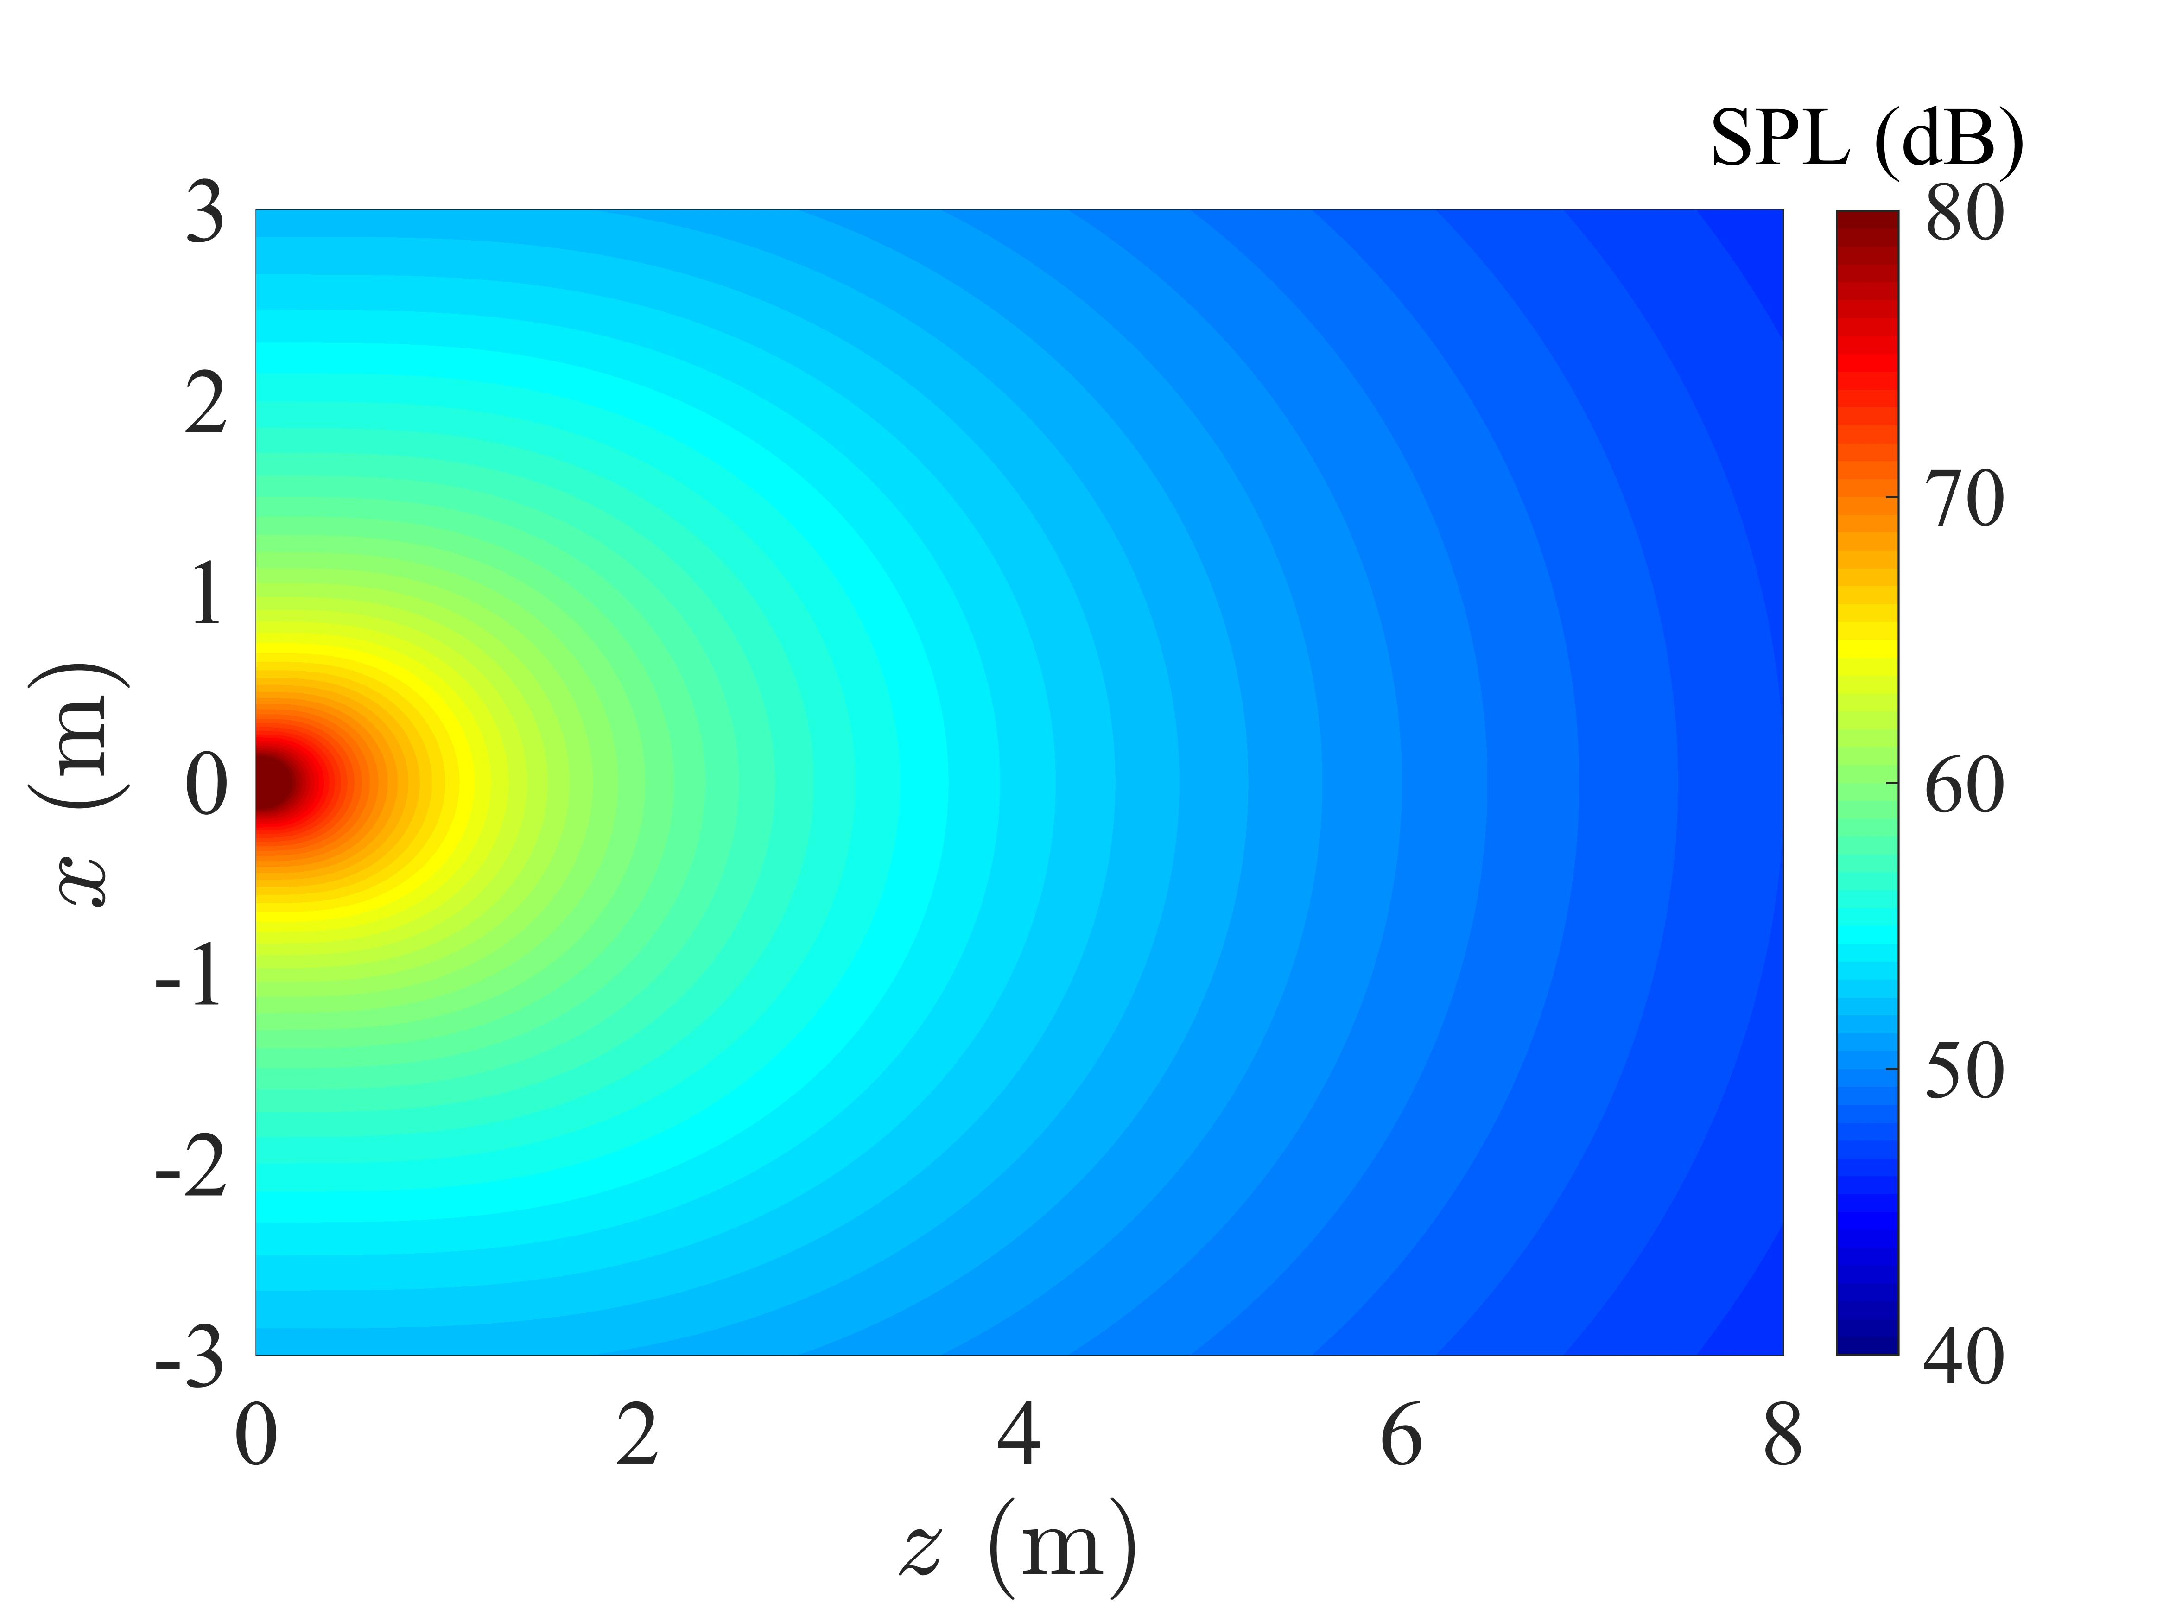
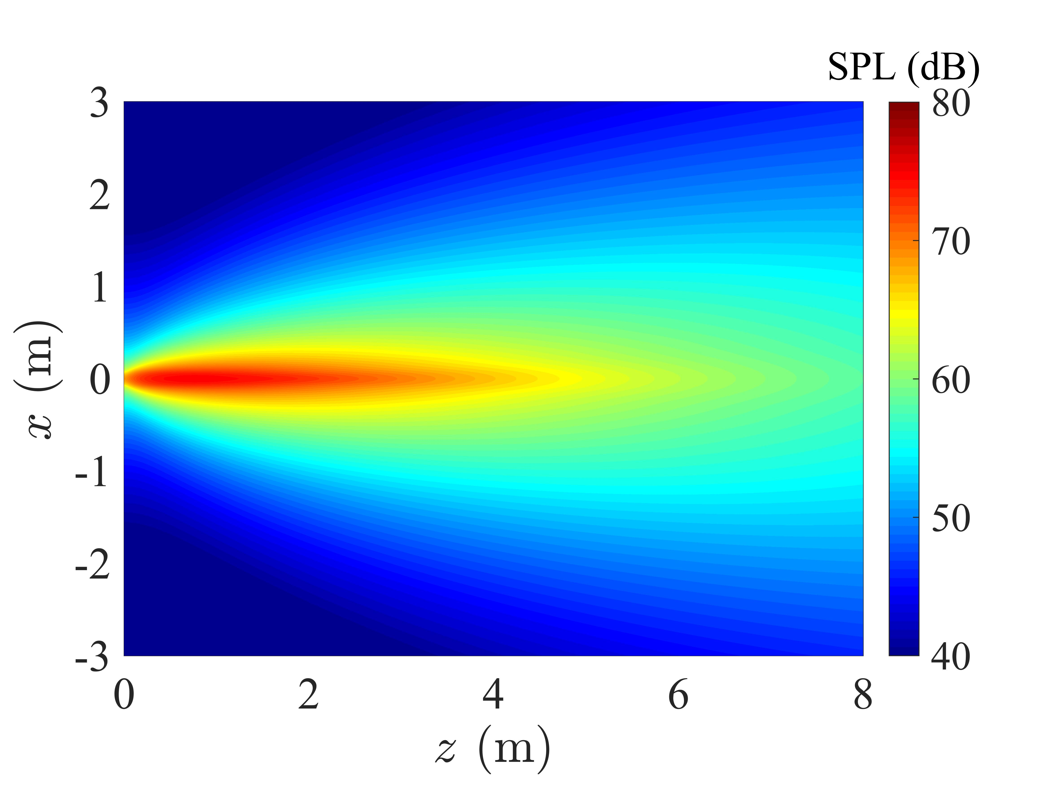
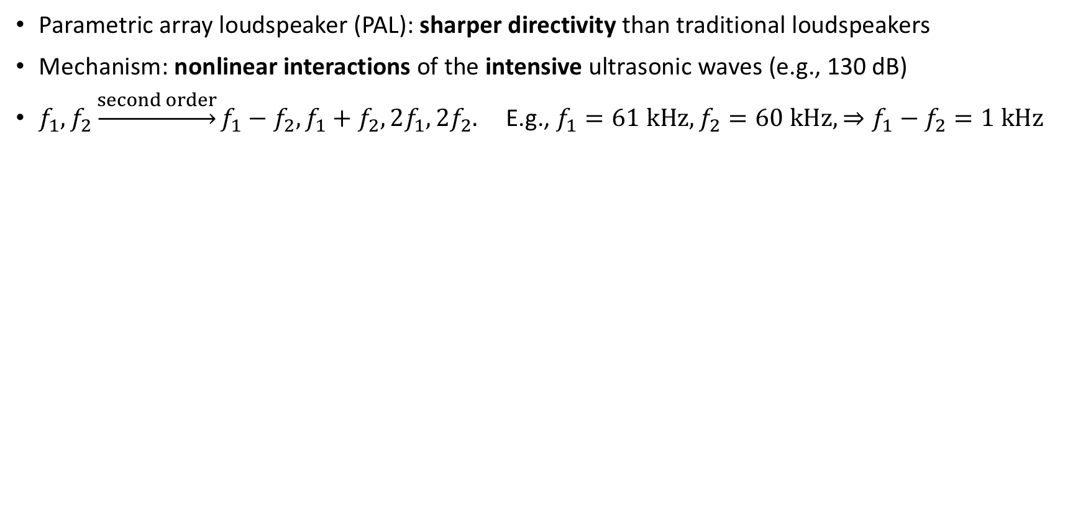
Introduction Parametric array loudspeaker (PAL)
Parametric array loudspeaker (PAL): sharper directivity than traditional loudspeakers
Mechanism: nonlinear interactions of the intensive ultrasonic waves (e.g., 130 dB)
$f_{1},f_{2}\underset{→}{second order}f_{1}−f_{2},f_{1}+f_{2},2f_{1},2f_{2}.$E.g., $f_{1}=61 kHz, f_{2}=60 kHz, ⇒f_{1}−f_{2}=1 kHz$
Fig. 2 SPL distribution at 1 kHz: (left) traditional loudspeaker; (right) PAL

Slide 5
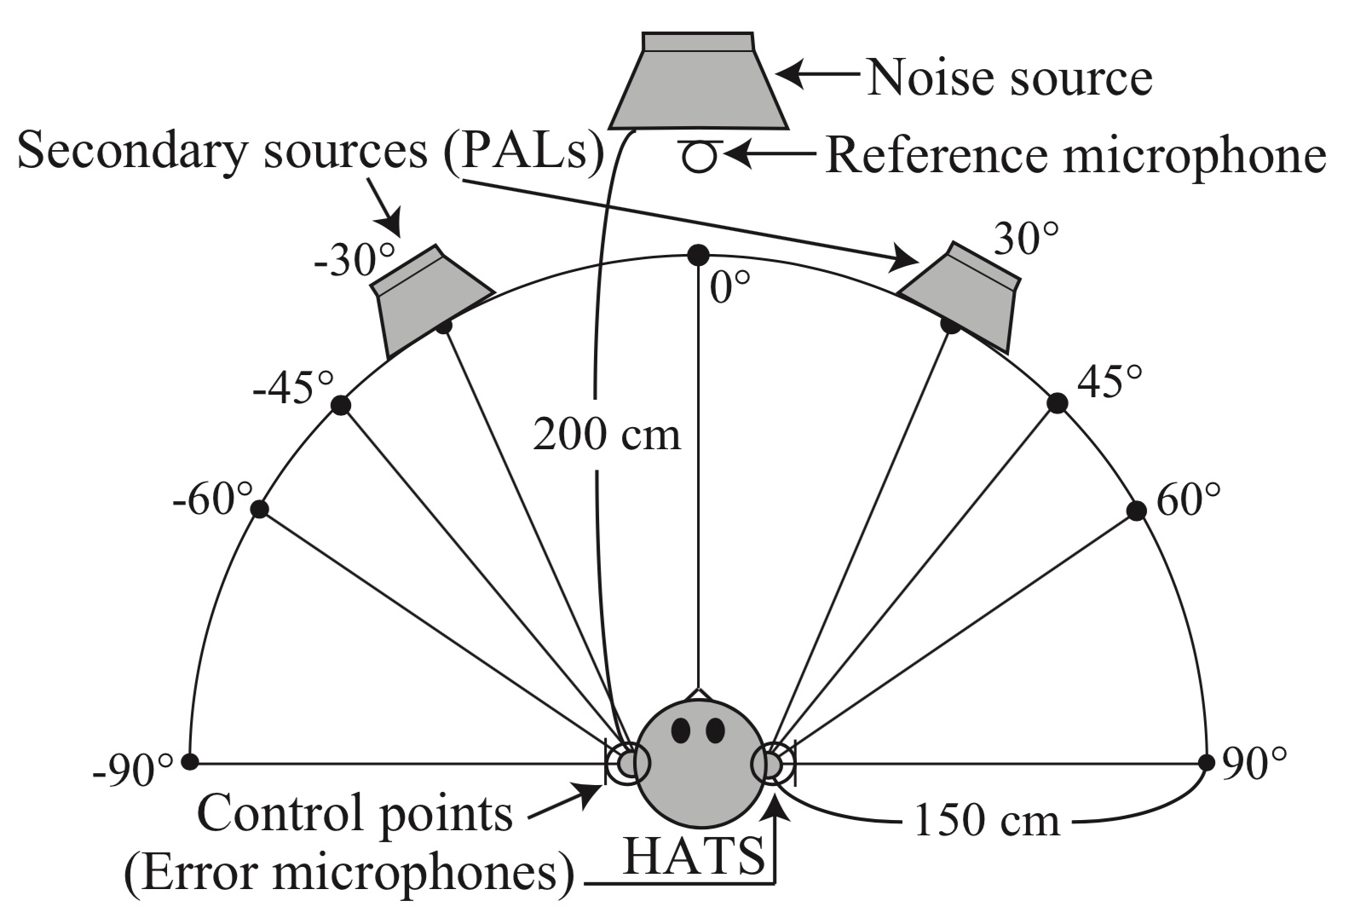
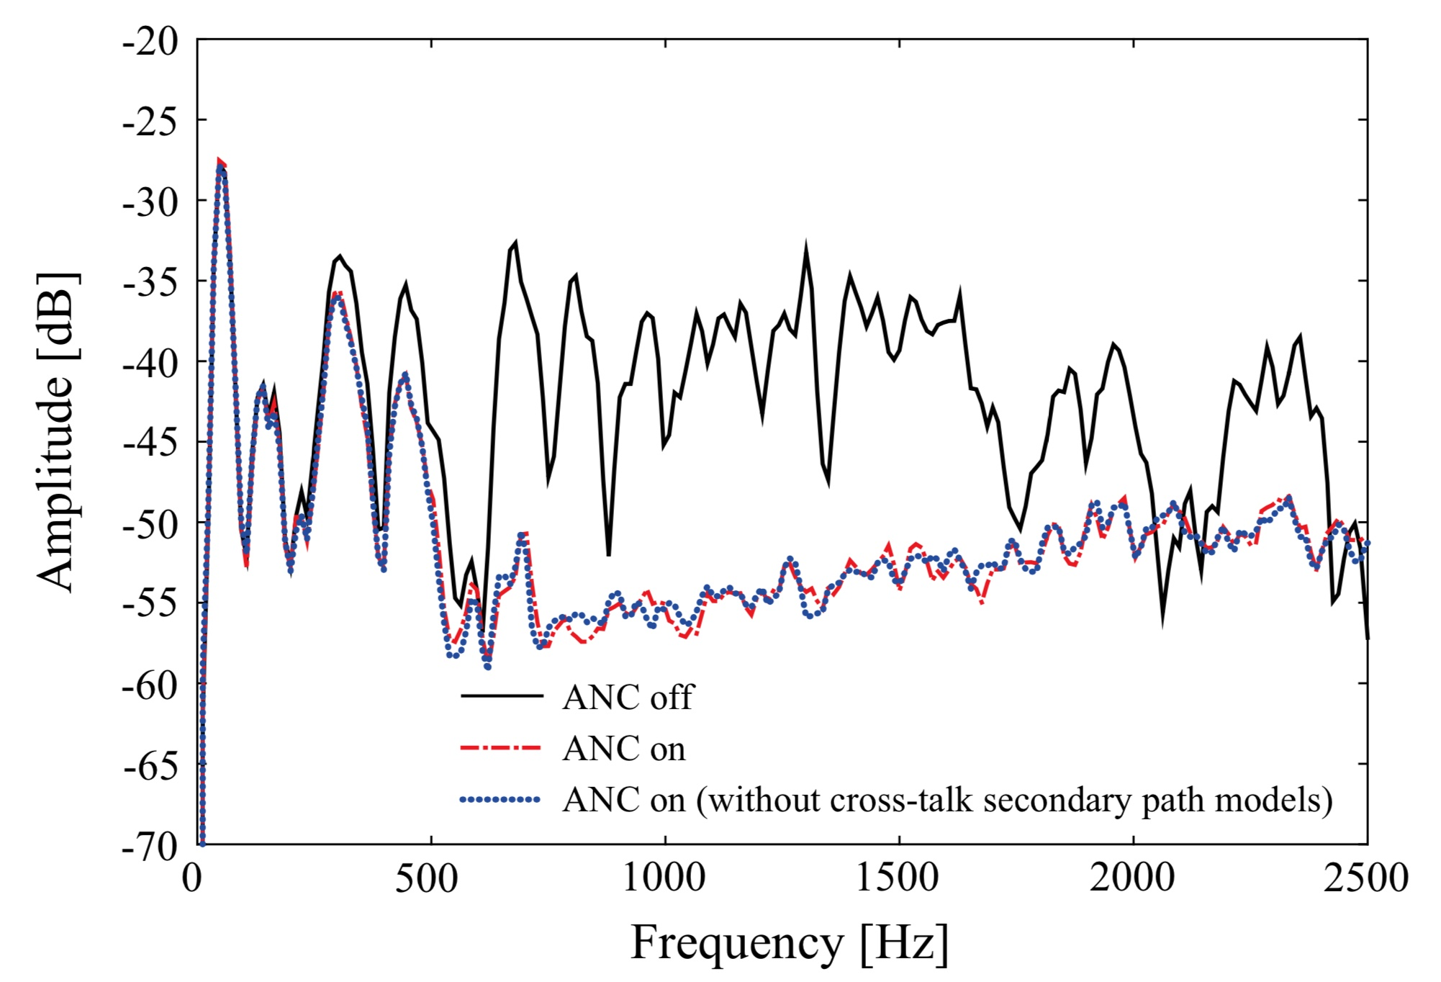
Introduction Existing research on ANC using PAL
Tanaka 2010: pure tone noise at 1.5 kHz
Tanaka 2017: broad band noise (600 Hz to 2 kHz), 10.4 dB overall noise reduction at ear
Research question: cancel a broader band noise up to 6 kHz using PALs?
Fig. 3 Binaural ANC using PALs: (left) sketch; (right) ANC performance at the ear of the HATS

Slide 6
Experiment Setup Layout
Fig. 4 Schematic diagram of the experiment setup

Slide 7
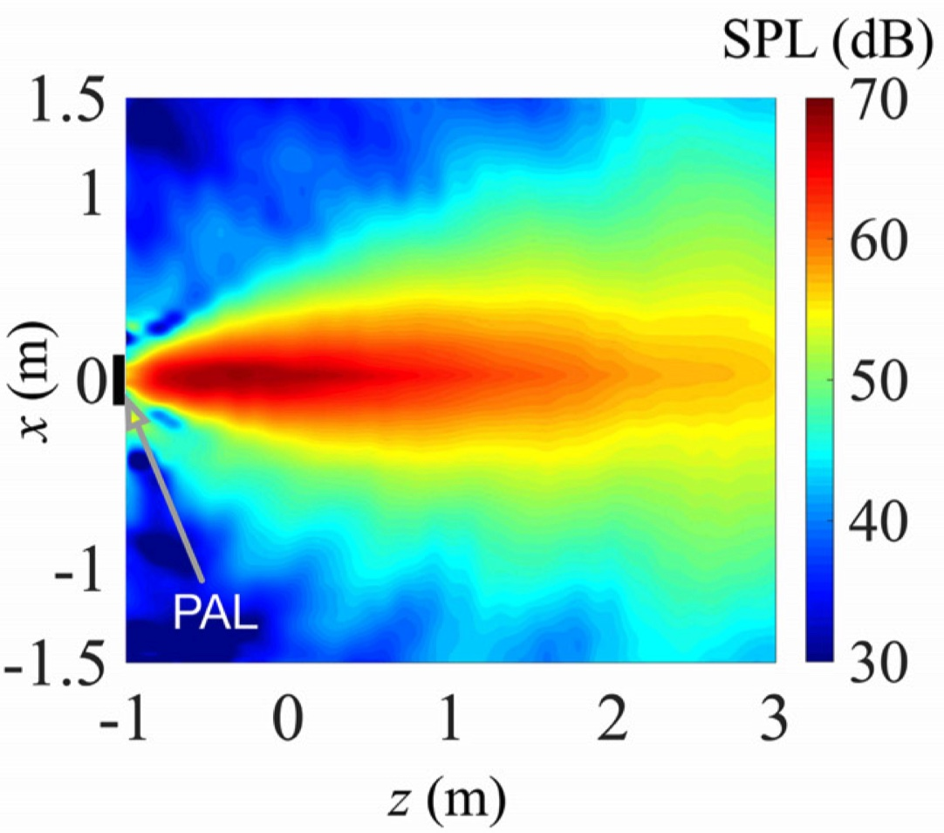
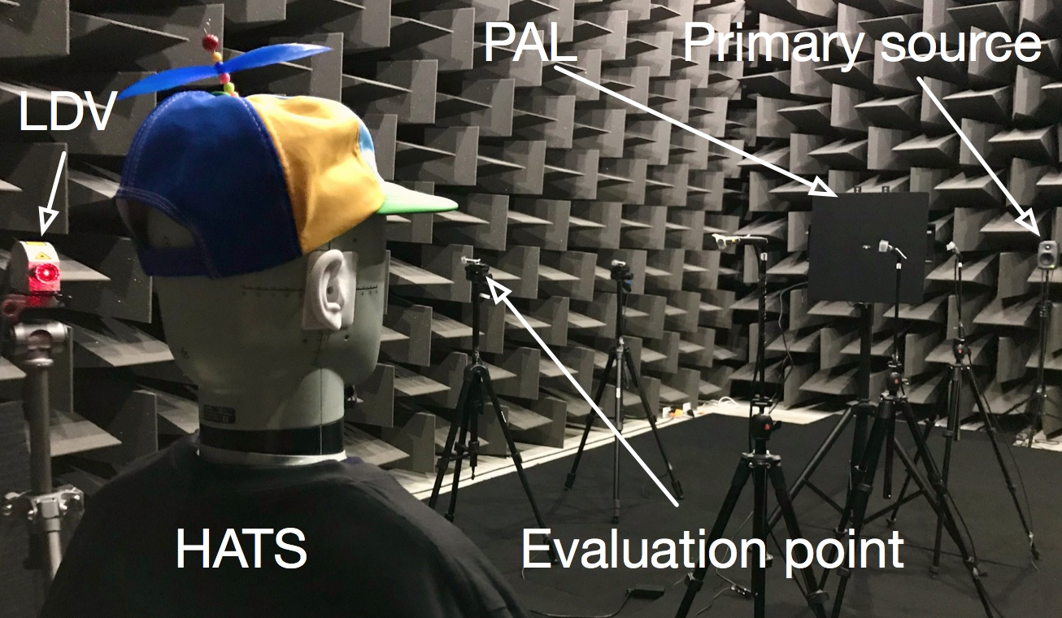
Experiment Setup Secondary source
PAL: Holosonics AudioSpotlight AS-24i
Traditional loudspeaker: Genelec 8010A
Fig. 5 (left) Photo of the experiment setup; (right) measured SPL distribution by the PAL at 1 kHz

Slide 8
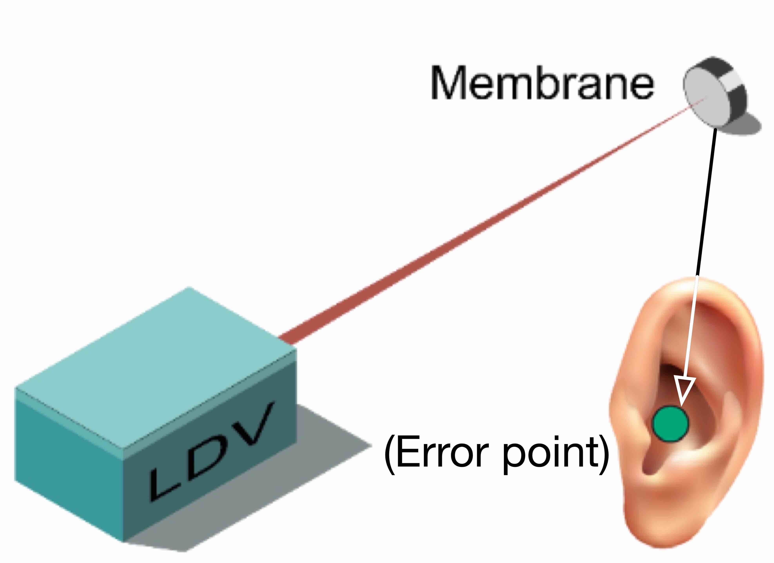
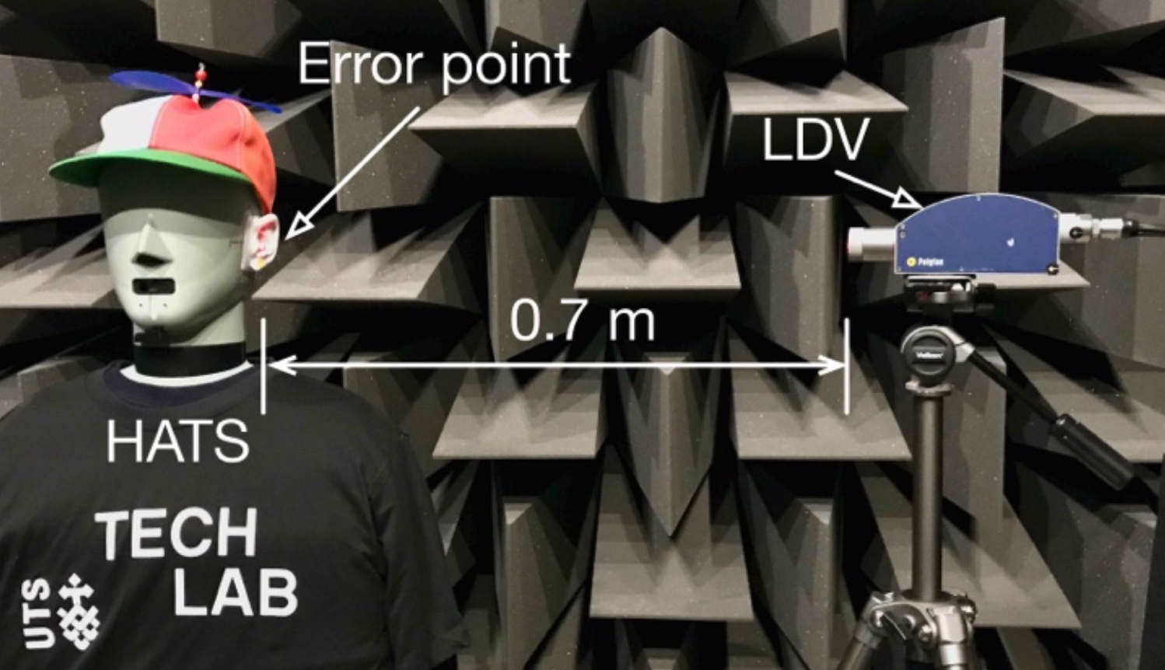
Experiment Setup Optical microphone using laser Doppler vibrometer (LDV)
Error sensor: remote acoustic sensing apparatus based on LDV
A custom-made membrane pick-up at the point of interest
Membrane vibration measured by an LDV
Effective frequency range: up to 10 kHz
Fig. 6 (left) Photo of the LDV error sensing system; (right) Sketch

Slide 9
Experiment Results At the ear simulator of the head and torso simulator
Overall noise reduction from 1 kHz to 6 kHz at the ear of the simulator
Traditional loudspeaker: 18.7 dB
PAL: 17.8 dB
Fig. 7 SPL measured by the left ear simulator of the HATS with and without ANC: (left) traditional loudspeaker,
(right) PAL, where the distance between the secondary source and error point is 1 m

Slide 10
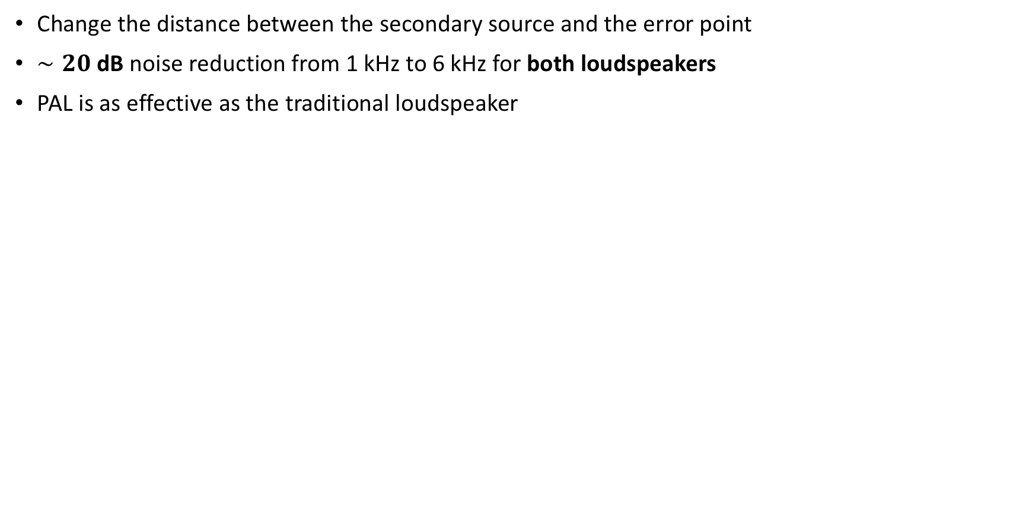
Experiment Results At the ear simulator of the head and torso simulator
Change the distance between the secondary source and the error point
$∼20$ dB noise reduction from 1 kHz to 6 kHz for both loudspeakers
PAL is as effective as the traditional loudspeaker
Fig. 8 Overall noise reduction from 1 kHz to 6 kHz at the left ear of the HATS as a function of the distance
between the secondary source and the error point

Slide 11
Experiment Results At evaluation points
Overall noise reduction from 1 kHz to 6 kHz at evaluation point #2
Traditional loudspeaker: −4.9 dB; PAL: −0.2 dB
PAL has less effects on the other areas
Fig. 9 SPL measured by evaluation point #2 with and without ANC: (left) traditional loudspeaker,
(right) PAL, where the distance between the secondary source and error point is 1 m.

Slide 12
Experiment Results At evaluation points
Overall noise reduction from 1 kHz to 6 kHz at all evaluation points
Traditional loudspeaker: noise levels ↑
Fig. 10 Overall noise reduction from 1 kHz to 6 kHz at 9 evaluation points as a function of the distance between
the secondary source and the error point: (left) traditional loudspeaker; (right) PAL

Slide 13
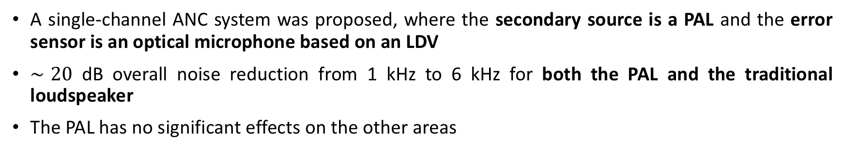
Conclusions
A single-channel ANC system was proposed, where the secondary source is a PAL and the error sensor is an optical microphone based on an LDV
$∼20$ dB overall noise reduction from 1 kHz to 6 kHz for both the PAL and the traditional loudspeaker
The PAL has no significant effects on the other areas
Future Work
Use the real reference signal and optimize the physical configuration
Develop an ANC headrest system using two PALs
Develop an accurate prediction model considering the scattering effects of the human head.
Thank you!

